Slide 1

Winter 2020 Takeback Research

Slide 2
Special Considerations due to COVID-19
COVID-19 restrictions have led to abnormal take back amounts for the Spring 2020 and Fall 2020 semesters.
All categorical and absolute analysis has been conducted in this context

Slide 3
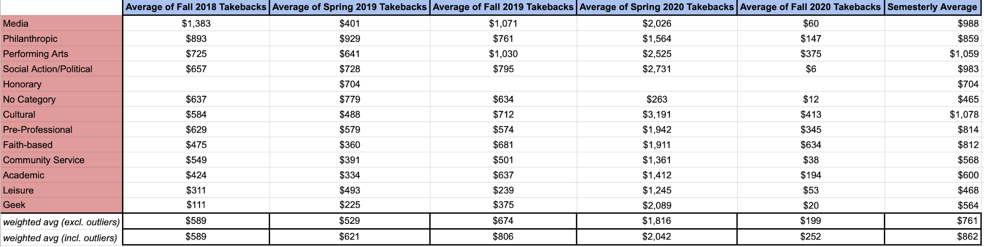
Categorical Analysis
Spring 2020:
153% increase in takebacks, due to unanticipated shutdown.
Most categories saw significant percentage increase in takebacks, especially Geek with 457%
Fall 2020:
Sharp decline in takebacks, 69% lower than pre-pandemic levels.
Attributed much lower requests, along with no requests in costly categories such as room rental/food/equipment.

Slide 4
Absolute Trends
As discussed in previous research, take backs were increasing semesterly, and the past two semesters serve as an anomaly.

Slide 5
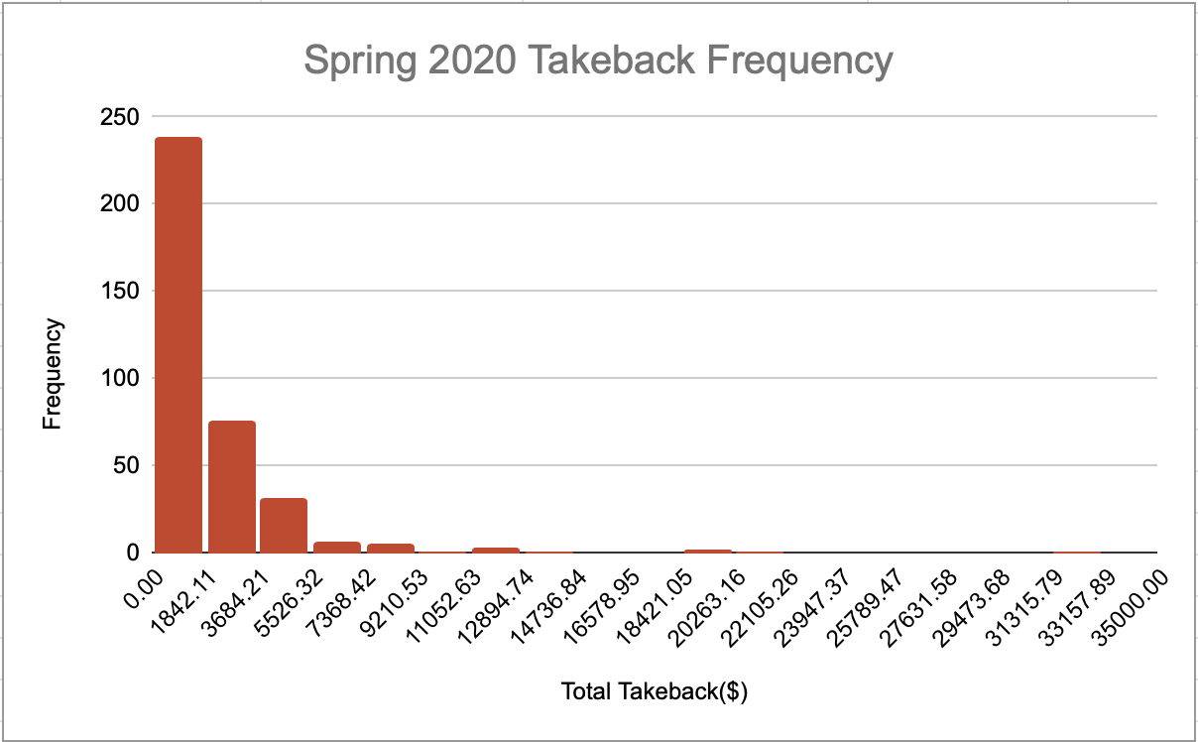
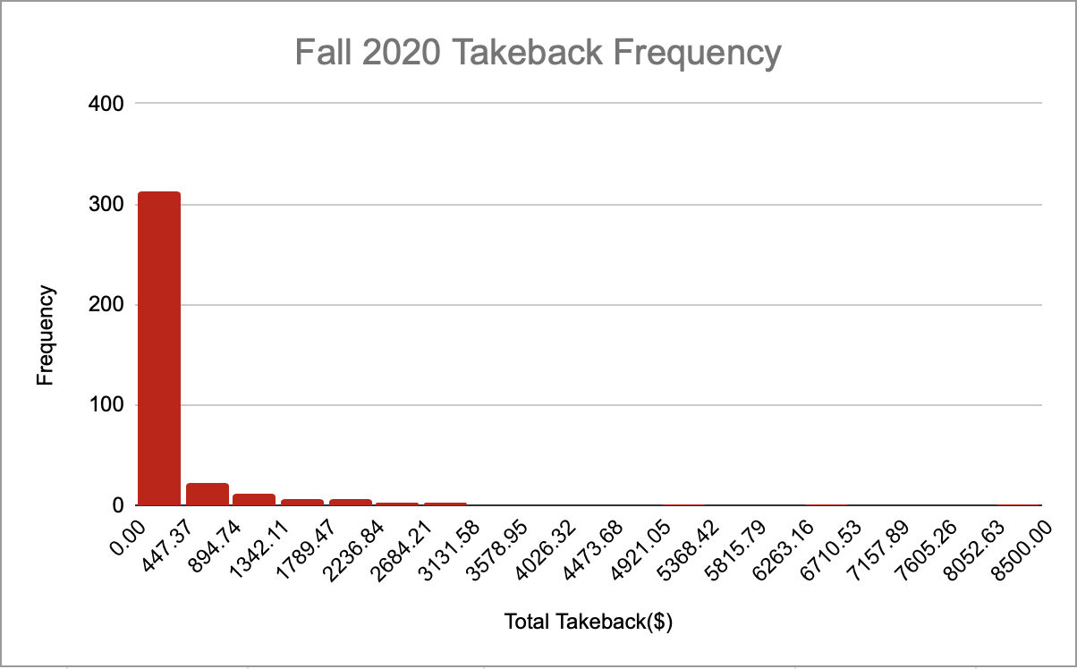
Frequencies
Spring 2020 saw more clubs with higher takebacks, and in the Fall most clubs fell within $0-447. Outliers with very large take backs remain in both semesters.

Slide 6
How to interpret COVID-era takebacks
In the event of the need for remote programming again, implementing a two-application system prevents large takebacks.
Takebacks are significantly smaller during a fully remote semester, which can possibly be attributed to no requests for room rental/equipment/food.
It should be assumed that upon coming back to campus policies should continue to be implemented in order to reduce takebacks(i.e. Dynamic cap system, attendance tracking)

